Slide 1



Introduction to Python
2019 SPLIT Program #6
Orientation
Yoon Kyung Lee
Human Factors Psychology Lab
Seoul National University

Slide 2
Contents
This workshop
What is Python?
Programming Essentials
Get Ready!
Anaconda
Jupyter Notebook
Colab Research Notebook (Google)
Python Programming
Variables
Print()
Plan

Slide 3
This workshop
Durations: 8 weeks, 8 hours minimum
Location: will be announced
Materials : github.com/yoonlee78/pythonbootcamp
Bring your own laptop
Window users: install Git Bash (https://gitforwindows.org/)
Minimum 2 hours of self-practice is expected

Slide 4
Contact
yoonlee78@snu.ac.kr
Or message me in Slack

Slide 5
Ice breaking!
Instructor: Yoon Kyung Lee
Ph.D. Program in Cognitive Psychology
Studying Human-Computer/AI Interaction
Nice to meet you. Now your turn!

Slide 6
Programming Essentials I

Slide 7
What is a programming language?
Program
A series of instructions/commands (a.k.a. bossing around)

Slide 8
What is a program?
Program
A series of instructions/commands to be carried out by a computer
Like a recipe:
https://slideplayer.com/slide/3455881/

Slide 9
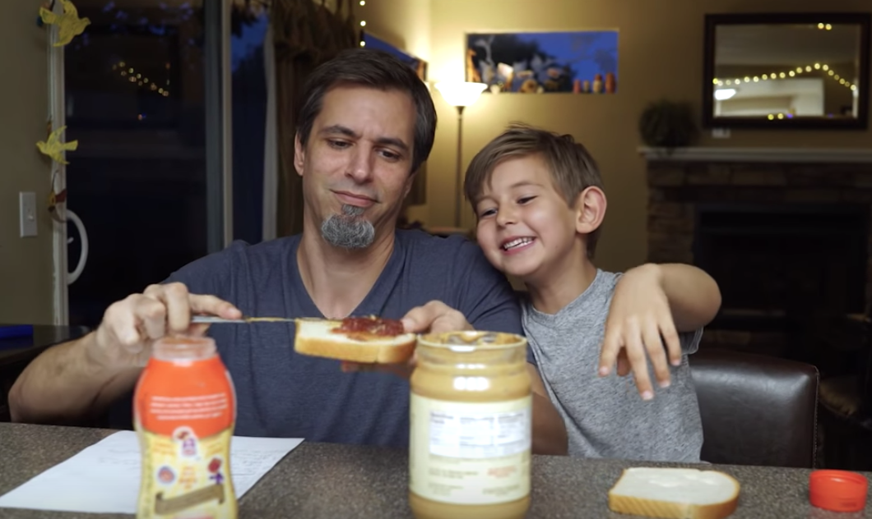
Exact Instructions Challenge: Peanut Butter Sandwich
https://www.youtube.com/watch?v=cDA3_5982h8

Slide 10
What is it to program?
Programming (to program)
Building programs. In other words, making series of instructions for a computer to follow.
You’ll spend most of the time asking questions as well.

Slide 11
What is a programming language?
Program Language
An “artificial language” used for programming

Slide 12
What is a programming language?
Program Language
An “artificial language” used for programming
You can make various types of data with a programming language: text, image, sound, video, 3D motion…etc.
Global Language : even better than English!
C, C++, JavaScript, Ruby … and Python!

Slide 13
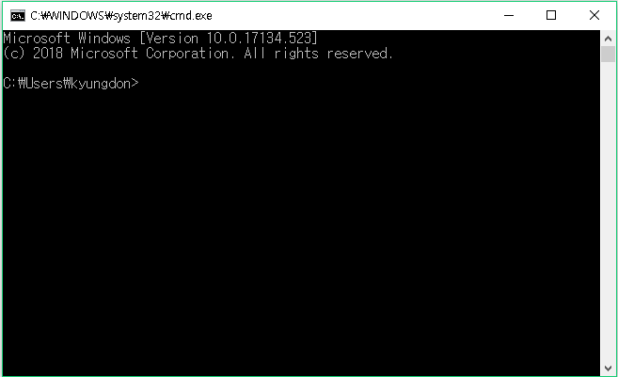
Terminal/Command
Windows Command

Slide 14
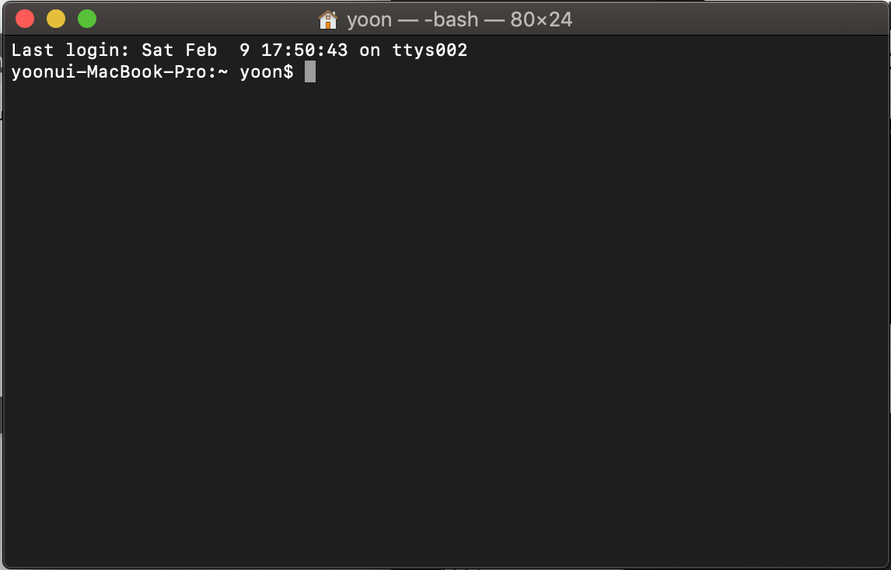
Terminal/Command
MacOS Terminal

Slide 15
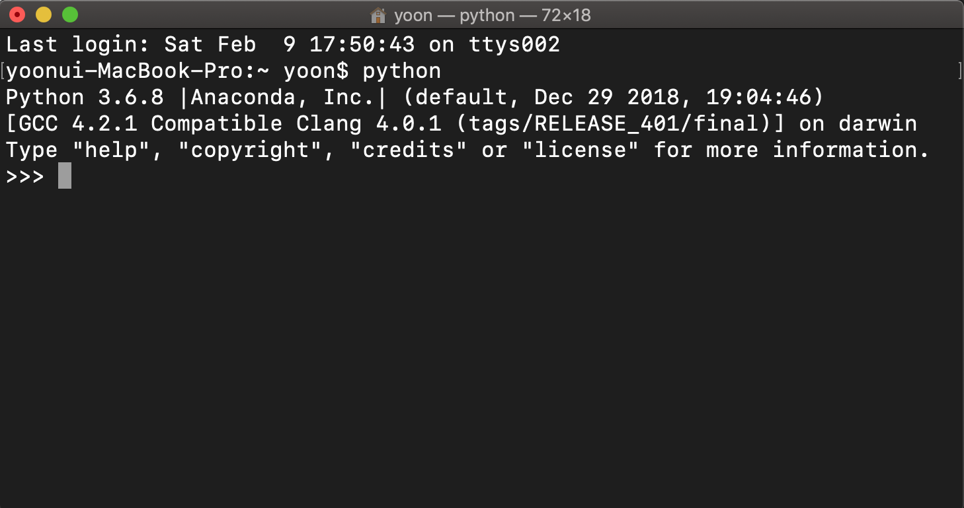
Console
Python console starts with ‘>>>’ sign
To start, ‘python’ > [Enter]
To quit, type ‘quit()’ or [ctrl + ‘d’]

Slide 16
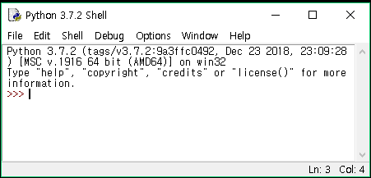
IDLE
When you install Python, an IDLE (Integrated Development and Learning Environment) platform comes with it.
We won’t use this often, instead we will use Jupyter Notebook (later in the slides).

Slide 17
Editor(s)
You can open/edit codes with text editors
There are many of them but some popular ones are: Microsoft VS code, SublimeText, Pycharm, Atom, and Notepad!

Slide 18
Programming Essentials II

Slide 19
What is Python?
Open-source, available at www.python.org
An interpreted, object-oriented language

Slide 20
What is Python?
Open-source, available at www.python.org
An interpreted, object-oriented language
Created by Guido van Rossum
Made over a night of Christmas! (1989.12.25)
Named after British comedy group (TV show), Monty Python

Slide 21
"Life is too short, You need python."
Guido Van Rossum

Slide 22
Zen of Python
Beautiful is better than ugly. Explicit is better than implicit. Simple is better than complex. Complex is better than complicated. Flat is better than nested. Sparse is better than dense. Readability counts. Special cases aren't special enough to break the rules. Although practicality beats purity. Errors should never pass silently. Unless explicitly silenced. In the face of ambiguity, refuse the temptation to guess. There should be one-- and preferably only one --obvious way to do it. Although that way may not be obvious at first unless you're Dutch. Now is better than never. Although never is often better than *right* now. If the implementation is hard to explain, it's a bad idea. If the implementation is easy to explain, it may be a good idea. Namespaces are one honking great idea -- let's do more of those!

Slide 23
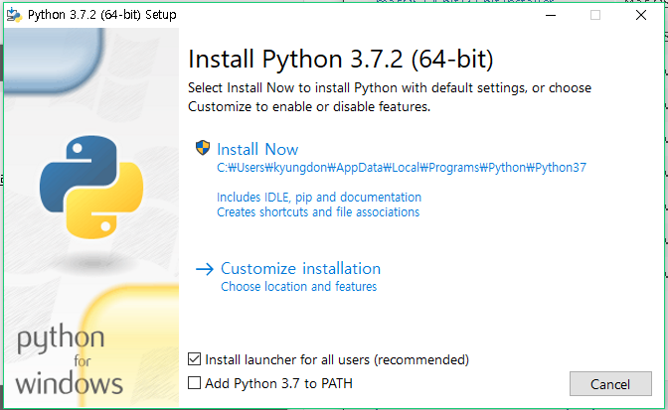
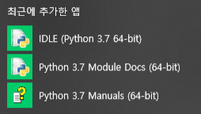
How to download python
DIY
www.python.org
Anaconda

Slide 24
How to download python
DIY
www.python.org
Anaconda
But skip for now

Slide 25

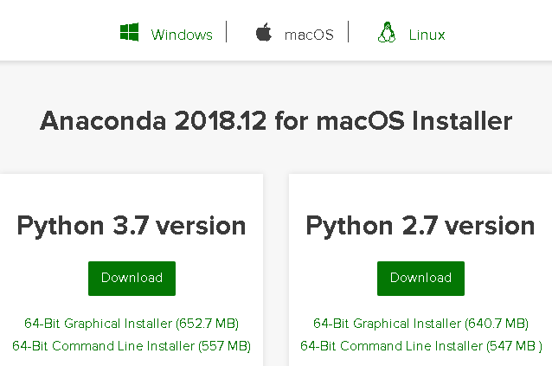
How to download python
2. Anaconda
Python Package Manger
Includes approx. 453 Python packages
Source: Continuum Analytics

Slide 26
How to download python
2. Anaconda
Download Anaconda first and only. It will be troublesome letter if you download both python and Anaconda.
Window users: check the version of your Windows!
Source: Continuum Analytics

Slide 27
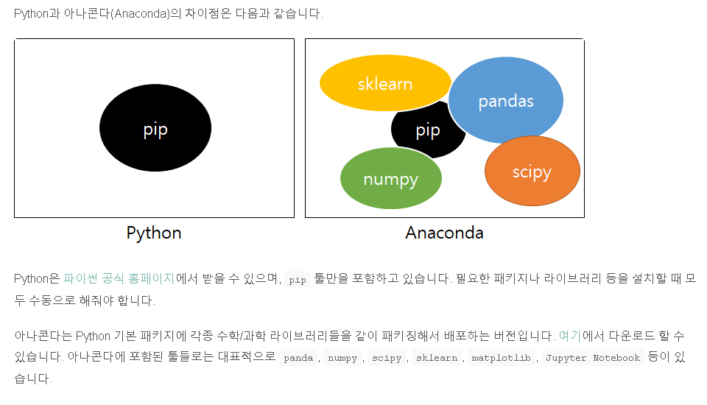
Anaconda vs Python Pip

Slide 28
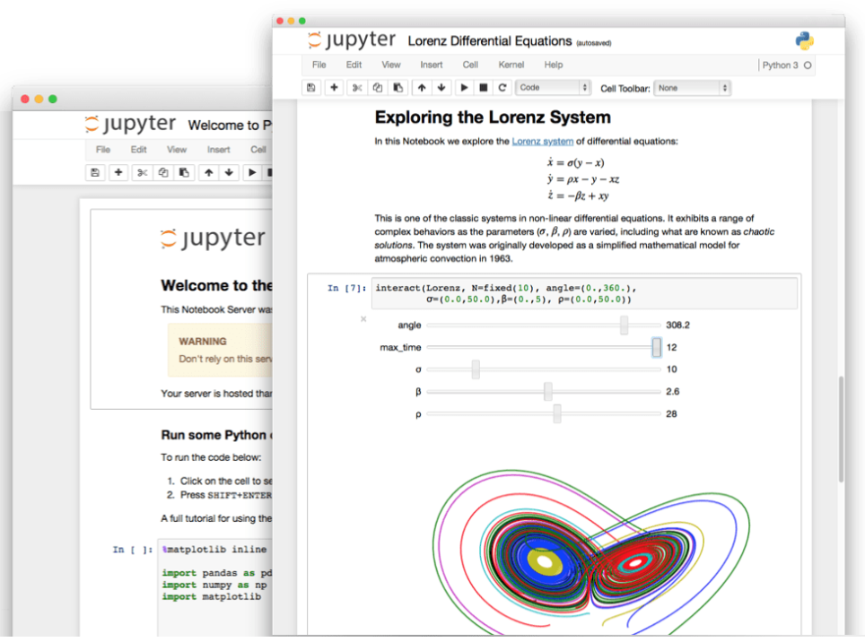
Jupyter Notebook
Data analysis platform
Composed of .ipynb file
ipynb = interactive python notebook
We are going to use this A LOT

Slide 29
Jupyter Notebook
Check this out:
Tutorial 1 :
[Jupyter Notebook Tutorial: Introduction, Setup, and Walkthrough] by Corey Schafer
https://www.youtube.com/watch?v=HW29067qVWk
Tutorial 2:
[Jupyter Notebook, readthedocs]
https://jupyter-notebook.readthedocs.io/en/stable/notebook.html

Slide 30
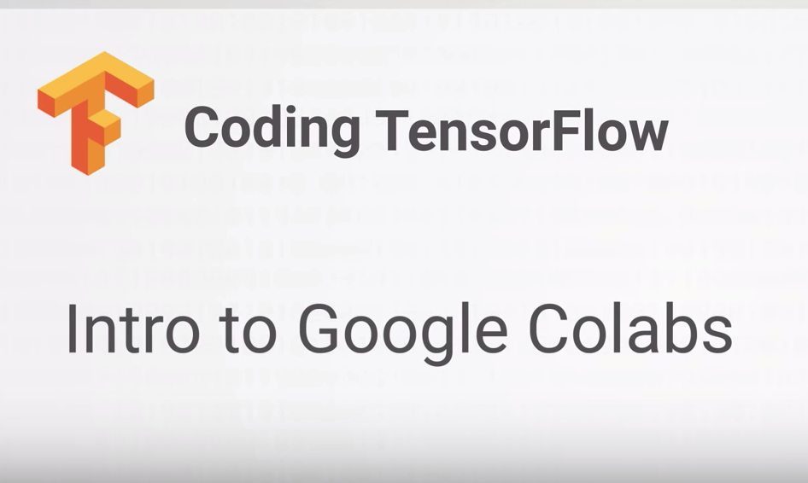
Colab Research Notebook
https://www.youtube.com/watch?v=inN8seMm7UI
https://colab.research.google.com/

Slide 31
Library & Package
List of python files you can summon and use whenever needed.
There are default ones embedded in Python
But most of the times you have to manually install them (or import them)

Slide 32
Library & Package
Python standard libraries:
https://docs.python.org/3/library/

Slide 33
Library & Package
TOP libraries you must know (2019 ver.)
- TensorFlow, Scikit-Learn, Numpy, Keras, PyTorch, SciPy, Pandas

Slide 34
Plan
W1: Orientation
W2: Numbers and Strings
W3: String Expression Methods and Formatting
W4: List, Tuple, Dictionary, Set, and Bool
W5: Flow, Control, If, While, For
W6: Functions and Files
W7: Class, Module, Packages
W8: NumPy and Pandas Quick Introduction

Slide 35
Next Week
Go to : https://github.com/yoonlee78/pythonbootcamp
Click each .ipynb file and check out the material
If .ipynb file does not load, try this:
Go to https://nbviewer.jupyter.org/
Insert the link of each notebook. For example, for W2 notebook insert this link: https://github.com/yoonlee78/pythonbootcamp/blob/master/W2_Numbers_and_String.ipynb

Slide 36
Next Week
Create your github account!
Github.com
What is Github?
https://www.youtube.com/watch?v=w3jLJU7DT5E

